Slide 1
Topic 10 Occupancy Grid Mapping

Slide 2
Autonomous mobile robots
autonomy
Vehicle
Actuators
Vehicle model
Sensors
Control
Vehicle autonomy
Path & motion planning
Localization
Perception
Independent from user
Localization & mapping
Independent from environment

Slide 3
Motivation
It is not always the case that a robot is equipped with a map a priori.
Even if a map exists, it is quite common that the as-is differs from the architectural drawings. If it did not differ, maps do not contain the layout of furniture.
Being able to learn a map greatly reduces the effort involved in using a robot.
Mapping is one of the core competencies of a truly autonomous robot.

Slide 4
A challenging problem
The hypothesis space of all possible maps is huge.
Maps can easily be described by 10⁵ or more variables.
It is therefore difficult to calculate full posteriors over maps.
Therefore the Bayes filtering approach is inapplicable to the problem of learning maps.
Learning maps is a “chicken-and-egg” problem. We refer to it as Simultaneous Localization And Mapping (SLAM)

Slide 5
SLAM
We can determine the robot’s pose when a map is available.
We can build a map of an environment if the robot’s pose is known.
In the absence of both robot pose and a map, we have to do both concurrently.

Slide 6
Why is mapping hard?
Size. The larger the environment relative to the robot’s range the more difficult it is to acquire a map.
Noise in perception & actuation. Sensors and actuators are noisy, the larger the noise, the more difficult the problem.
Perceptual ambiguity. This problem is due to similarities in the appearance of different places
Cycles. This problem occurs when we try to close the loop coming around from a direction different than the departure direction.

Slide 7
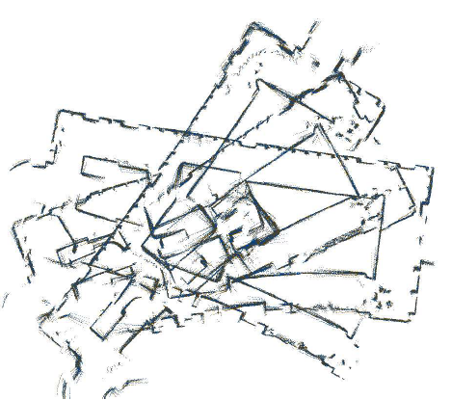
Range data (using odometry/laser)

Slide 8
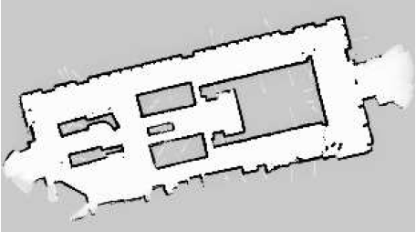
Produced map (Using OGM assuming perfect odometry)

Slide 9
Mapping with known poses
In this chapter we study the mapping problem under the assumption that the robot poses are known.
x_{t-1}
x_{t}
x_{t+1}
z_{t-1}
z_{t}
z_{t+1}
m

Slide 10
Occupancy Grid Maps (OGM)
Occupancy grid maps address the problem of generating consistent maps from noisy & uncertain measurement data, under the assumption that the robot pose is known.
The basic idea here is to represent the map as a field of random variables, arranged in an evenly spaced grid.
Each random variable is binary and corresponds to the occupancy of the location it covers.
OGM algorithms implement approximate posterior estimation of those random variables.

Slide 11
OGM application
OGM is used in post-processing.
Many SLAM maps are not fit for path planning and navigation.
OGM are used after SLAM and by using the resulting path estimates for granted.

Slide 12
OGM algorithm
The gold standard of any OGM is to calculate the posterior over maps given the data:
sequence of all poses
map
measurements up to time t
The controls u_{1:t} play no role in OGM since the path is already known.

Slide 13
Type of maps
The most common type of maps are the 2-D floorplan maps (2D slice of 3D world)
This type of maps is usually sufficient to represent the world upon which the robot is navigating.
OGM generalize to 3-D representations (much more computation and then we talk of 3D voxels)
We will note p(m_{i}) as the probability that grid cell ‘i’ is occupied.
m_{i} = 1 (occupied)
m_{i} = 0 (free)

Slide 14
Dimensionality problem
The problem with OGM is the dimensionality.
If a typical map has roughly 10,000 grid cells, the number of possible maps defined in this space > 2^{10,000}
Therefore it is intractable to calculate a posterior for each single possible map.
Instead in OGM we break up the problem into easier problems
Each grid cell

Slide 15
New Posterior
The new posterior over maps is approximated as the product of its marginals.
The estimation of the OGC for each cell is now a binary estimation problem with static state.
A filter for this type of problem was discussed in Chapter 4.2 (binary Bayes filter)

Slide 16
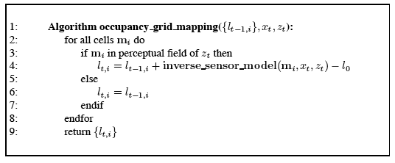
OGM algorithm
where:
and:

Slide 17
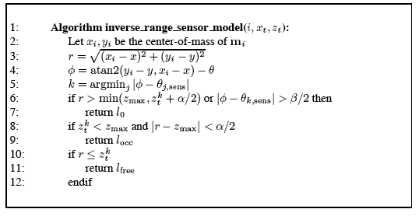
Inverse sensor model function
It implements the inverse measurement model p(m_{i}|z_{t}, x_{t}) in its log-odds form.
k
z_{t}

Slide 18
Inverse sensor model function
Here the width of the region is controlled by α and the opening beam by β.
The beam index k and the range r are first determined for the center of mass of the cell m_{i} (lines 2-5 in Table 9.2).
l_{occ} > l_{o} if cell is within ± α/2 of the detected range z_{t}
l_{free}<l₀ if the range is shorter than the measured by more than α/2

Slide 19
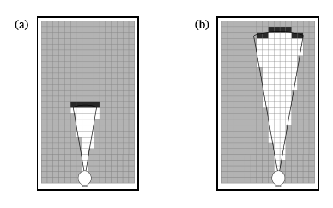
Examples

Slide 20
Building the map using sonar readings

Slide 21
Final map

Slide 22
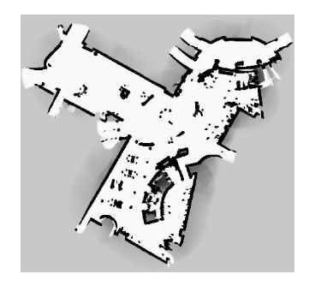
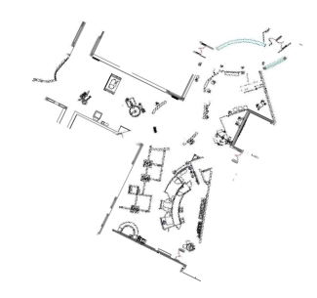
Example of OGM performance
Generated by OGM
Architectural blue-print

Slide 23
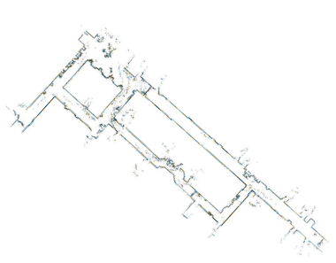
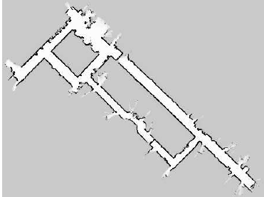
Example of OGM performance
Raw data from SLAM
OGM built from SLAM map

Slide 24
What to do with robot space
When the robot’s pose is x_{t}, the region surrounding x_{t} must be navigable.
IN practice, we return a large negative value for all grid cells occupied by a robot when at x_{t}.

Slide 25
Multi-sensor fusion
Robots are often equipped with more than one sensor type.
A natural objective is to integrate information from more than one sensor into a single map.

Slide 26
Multi-sensor fusion
Fusing data from multiple sensors with Bayes filters is not an easy endeavor.
One way would be to implement ‘occupancy_grid_mapping’ algorithm with different sensor modalities.
However such an approach has a drawback. If different sensors detect different types of obstacles, the result of Bayes filter is ill-defined.
Sensor types can generate conflicting information.

Slide 27
Multi-sensor fusion
A popular method is to build separate maps for each sensor type, and integrate them using an appropriate combination function.
Using De Morgan’s law:
map built by the k^{th} sensor
Alternatively, we can compute the maximum:

Slide 28
Inverse measurement models
The occupancy grid mapping requires a marginalized inverse measurement model p(m_{i}| x, z)
This probability is called inverse since it reasons from effects to causes. It provides information about the world conditioned on measurements caused by this world.
It is marginalized for the i-th grid cell since a full inverse would be of the type p(m|x,z)

Slide 29
Inverse measurement models
We can obtain an inverse model in a more principled manner, starting at the conventional measurement model.
The inverse model for the i-th grid cell is obtained by selecting the marginal for the i-th grid cell

Slide 30
Sampling from the forward model
If we can generate for any grid cell random triplets of :
poses x_{t},
measurements z_{t},
and map occupancy values m_{i}
then we can learn a function that accepts a pose x_{t} and measurement z_{t} as an input and outputs the probability of occupancy for m_{i} as output
[k]
[k]
[k]
[k]
[k]
[k]

Slide 31
Sampling from the forward model
[k]
[k]
[k]
A sample of the form (x_{t} z_{t} m_{i} ) can be generated as follows:
Sample a random map m^{[k]} ~ p(m).
Sample a random pose x_{t} inside the map. One can assume the poses are uniformly distributed.
Sample a measurement
Extract the desired true occupancy value m_{i} for the target grid cell from the map m.
The result is a sampled pose poses x_{t}, a measurements z_{t}, and map occupancy values m_{i}
[k]
[k]
[k]
[k]

Slide 32
Sampling from the forward model
Repeated application of this sampling step yields a data set:
These can be used as training examples for the supervised learning algorithm (Neural Network), which approximates the desired conditional probability p(m_{i}|z,x)

Slide 33
Maximum a Posteriori (Map)occupancy Mapping
Recalling:
How faithful should we be in the result of any algorithm that relies on such a strong decomposition?

Slide 34
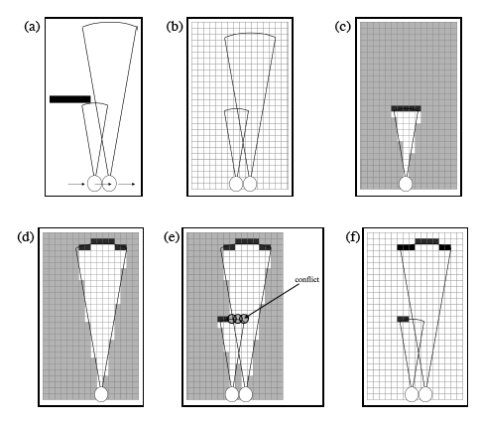
Problem with standard OGM

Slide 35
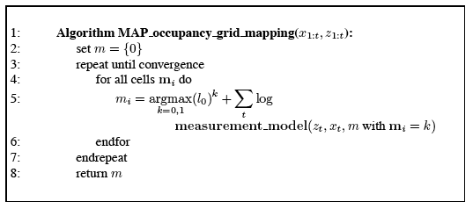
MAP occupancy mapping

Slide 36
OGM with forward models
The dependencies between neighboring grid cells are incorporated by an algorithm that outputs the mode of the posterior, instead of the full posterior:
The map posterior factors into a map prior and a measurement likelihood:

Slide 37
OGM with forward models
The log-likelihood log p(z_{1:t}|x_{t},m) decomposes into a sum of individual measurement log likelihoods:
The log prior also decomposes:
prior probability of occupancy
Number of grid cells in the map

Slide 38
OGM with forward models
For the log version of the prior we get:
It suffices to optimize:

Slide 39
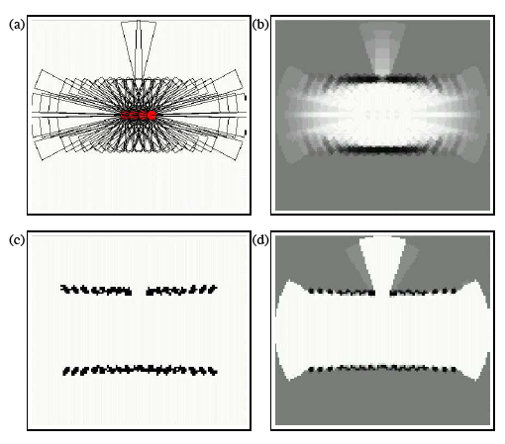
MAP occupancy grid mapping

